Slide 1

SESSION 2023-2024
TITLE OF THE MINI PROJECT
PRESENTED BY :
ANIMESH SINHA (2101921520031)
UNDER SUPERVISION OF :
SUPERVISOR’S NAME:
MR. MOHIT KUMAR

Slide 2
INTRODUCTION OF THE PROJECT
The MERN Stack Blood Bank Project represents a web application designed to streamline blood donation and inventory management. Leveraging the powerful combination of MongoDB, Express.js, React.js, and Node.js, the project seeks to enhance the efficiency, accessibility, and user experience within the realm of blood donation.
The project's foundational components include a user-friendly registration and login system, robust user authentication mechanisms, and distinct roles such as Donor, Organization, Hospital, and Admin. Each role is tailored to offer specific privileges and responsibilities, fostering a collaborative environment for users across the blood donation ecosystem.

Slide 3
OBECTIVES
The Blood Bank App aims to enhance communication between the Donor, Hospital and Organisation. The primary objectives of the MERN Stack Blood Bank Project are:
Efficient Blood Donation Process
Optimized Blood Inventory Management
Enhanced User Authentication and Security
Distinct Roles for Varied Users
Real-Time Data features
User interface
Testing and Improvement
Deployment

Slide 4
HARDWARE & SOFTWARE REQUIREMENTS
**Hardware:**
1. Server Infrastructure
2. Storage Systems
3. Network Infrastructure
4. Backup Systems
**Software:**
1. Operating System
2. Node.js
3. Express.js
4. MongoDB
5. React.js
6. UI/UX Design Tools (for e.g. Adobe XD or Figma)
7. Version Control (e.g., Git)
8. Integrated Development Environment (IDE) (for e.g. VS code)
9. Deployment Platform (for e.g. Heroku)
10. API Testing Tool (for e.g. Postman)

Slide 5
EXISTING SYSTEM/RELATED WORK
In exploring the existing landscape of blood donation and inventory management systems, it was evident that traditional manual methods fell short in meeting the dynamic and specialized requirements of modern blood banks. Online blood donation platforms and mobile applications, while facilitating donor engagement, often lacked the comprehensive features necessary for efficient inventory management. Recognizing these limitations, the Blood Bank App aims to bridge the gap by introducing a technologically advanced, user-friendly solution that integrates real-time features, distinct user roles, and a comprehensive inventory management system tailored to the unique needs of donors, organizations, hospitals, and administrators.

Slide 6
LITERATURE SURVEY
S. No | Date | Year | Author | Title | Paper Published in (Journal Name..) | Conceptual Framework | Methodology | Conclusion | Future research
1. | 10 February 2020 | 2019 | Smith, J. | Innovations in Blood Bank Technologies | Journal of Health Informatics | Integration of Real-time Tracking and Data Analytics. | Review of Technological Trends in Blood Banking | Emphasis on User-Centric Approaches | Explore Blockchain Applications in Healthcare

Slide 7
MOTIVATION/PROBLEM STATEMENT
The blood donation ecosystem often faces challenges related to inefficiencies in blood inventory management, communication gaps between donors, organizations, hospitals, and the need for a secure and user-friendly platform. Traditional methods for tracking blood donations and managing inventory lack the efficiency required in emergency situations. Additionally, ensuring data security and privacy is paramount. In response to these challenges, the Blood Bank App aims to address these critical issues by leveraging modern web technologies to create a comprehensive and secure solution.
Challenges:
Technological Constraints
User Adoption Challenges
Data Privacy Concerns
Continuous Maintenance Demand

Slide 8
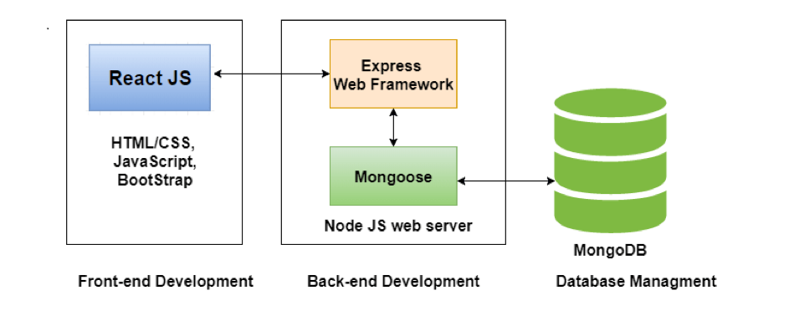
DESCRIPTION OF PROJECT (In Form Of Diagram)
Blood BANK APP

Slide 9
PROJECT DETAILS (Description Of Various Modules)
MODULE 1 : Authentication Module
MODULE 2 : Inventory Management Module
MODULE 3 : Integration and API Module

Slide 10
PROJECT DETAILS (Description Of Various Modules)
Authentication Module:
User Registration
User Login
Role Based Access Control
Inventory Management Module:
Blood Inventory Tracking
In & Out blood record Calculation
Organisation and Hospital Requests.
Integration and API Module
Versioning and compatibility
Authentication and Authorization in APIs
Data Standardization

Slide 11
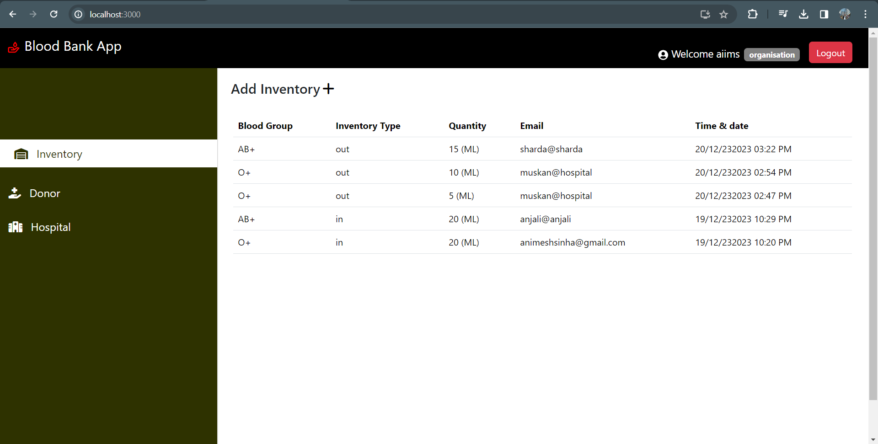
SCREENSHOTS OF RESULT (If Any)

Slide 12
CONCLUSION & SCOPE OF PROJECT
Conclusion:
The Blood bank App stand at the forefront of technological innovation. The combination of MongoDB, Express.js, React.js, and Node.js has empowered the development of a robust and user-centric platform. The project aims to address the dynamic needs of donors, organizations, hospitals, and administrators
Future Scope:
While the current version of the application does not include a search feature, there are plans to incorporate this functionality in future updates. This addition would significantly enhance the user experience, allowing for easier discovery of donors, specific blood types, or nearby hospitals.

Slide 13
REFERENCES
YouTube.
MongoDB Documentation. (2023). [Online]. Available: https://docs.mongodb.com/
Node.js Documentation. (2023). [Online]. Available: https://nodejs.org/en/docs/
Express.js Documentation. (2023). [Online]. Available: https://expressjs.com/
React.js Documentation. (2023). [Online]. Available: https://reactjs.org/docs/getting-started.html

Slide 14
Thank You

